Slide 1

Object Detection & Tracking in 4D RADAR for Enhanced Autonomous Vehicle Perception
Presented by Nick Timaskovs

Slide 2
Objectives:
To overcome the difficulty of working with 4D RADAR data.
Successfully implement object detection and tracking.
Experiment with variation in model configurations for improved results.
To learn and understand 4D RADAR point cloud data structure.
To learn and understand how object detection, tracking, and classification is achieved in 4D RADAR.

Slide 3
Aim of Thesis
The aim of this thesis is to develop and or implement an Object Detection and Tracking architecture for 4D RADAR, for enhanced Autonomous vehicle perception.
Create a UI for visualizing the detections during model evaluation.
Preform experiments on various model configurations.

Slide 4
Current issues faced in autonomous vehicles
Sensor Fusion and Perception
Clutter and Interference
Detection of Vulnerable Road Users
Safety and Reliability
Data Collection and Processing
Cost and Implementation

Slide 5
Motivation:
Motivations
Personal Experience - wanting to improve road safety
Specialize in computer vision & ML to work in this field
Improve current solutions to help drive innovation in ADAS
Interest in the automotive industry.

Slide 6
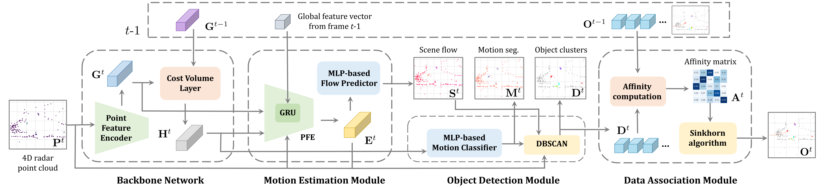
Architecture Used

Slide 7
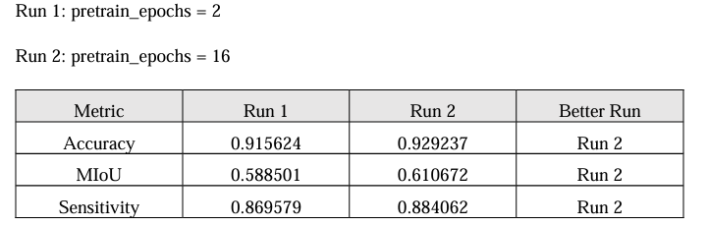
Segmentation Results

Slide 8
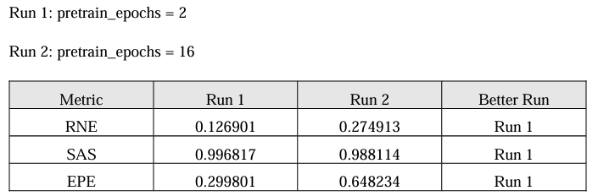
Scene Flow Results

Slide 9
Challenges Faced
Dataset Acquisition
Clutter and Interference
Detection of Vulnerable Road Users
Safety and Reliability
Data Collection and Processing
Cost and Implementation

Slide 10
Questions?

